Slide 1
Whale Collision Tool
CanDev 2022 - Team 4044
Stuart Shelley
Khuong Vinh Khang Tran
Daksh Kashyap
Gordon Tang

Slide 2
Problem Statement and Solution Overview
Problem Statement: modelling the risk of collisions between ships and whales and to integrate this information into planning and policy decisions that impact endangered species
Solution: Whale Warning System
Central system
Feed data to applications
Alert about slow zones area and whale habitat
Provide real-time data analytics
Notes:
Problem statement: modelling the risk of collisions between ships and whales and to integrate this information into planning and policy decisions that impact endangered species
Solution: Whale Warning System
Central system that collect data from various sources and store them in the database
Feed data to applications so that many user can use for many cases
An application that can alert the vessel captain about slow zones area and whale habitat
Provided tools and functionality for data analytics

Slide 3
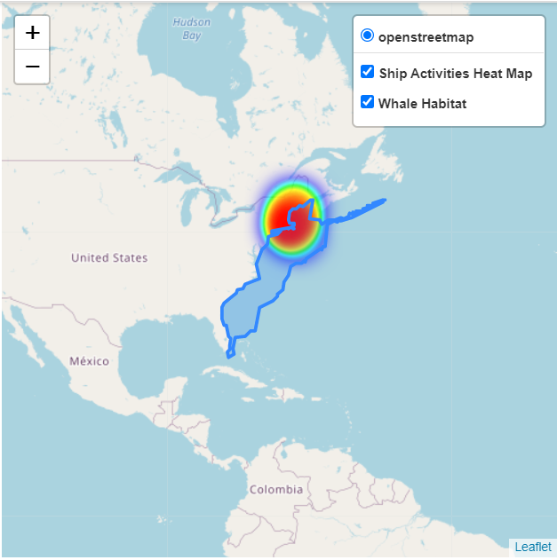
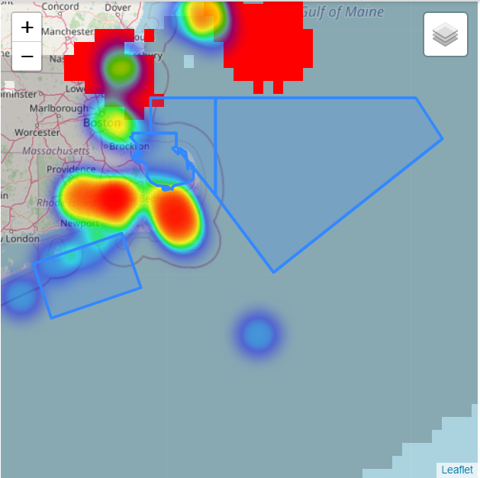
Heatmap of Vessel Speed with Whale Habitat area and Slow Zones
Notes:
-Developed heat maps using AIS data

Slide 4
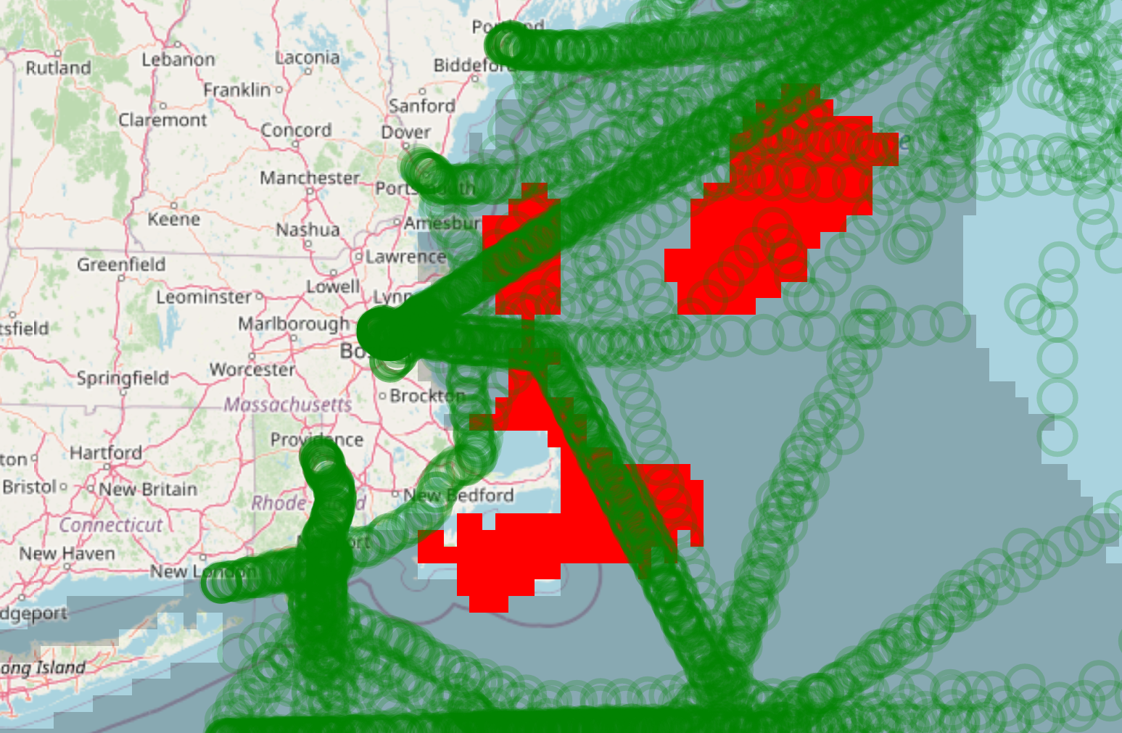
Shipping Lanes and Vessel Paths Overlap Potential Whale Locations
AIS Vessel Path Data Plotted on Suitable Whale Habitat Locations for April

Slide 5
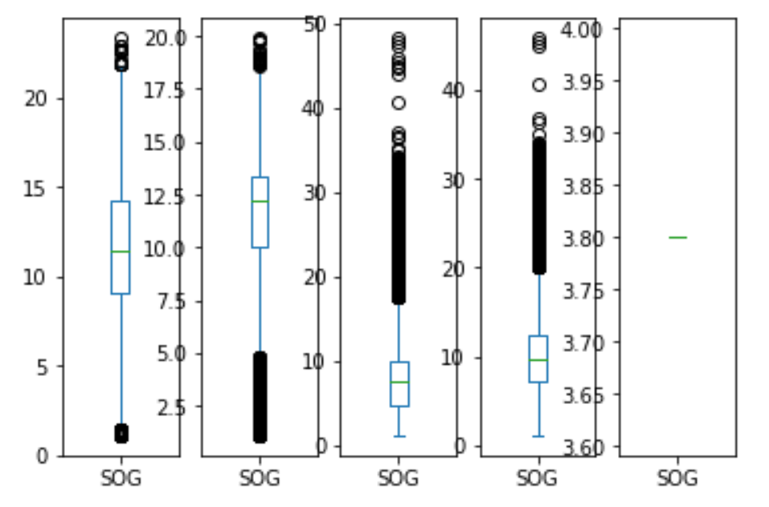
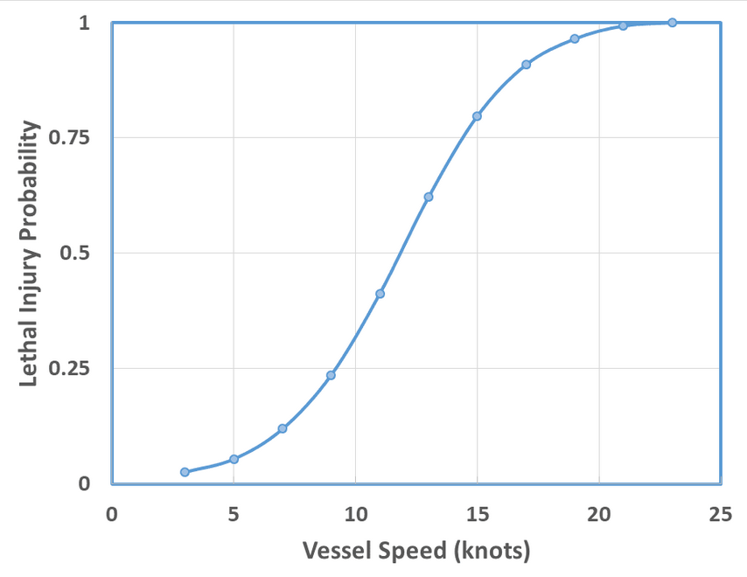
Large Vessels at High Speeds Injure Whales
Vessel Speed [knots] by Vessel Type
Whale Lethality Model (DFO)
Cargo
Passenger
Military
Tanker
Tugtow
Notes:
The types of ship we will focus on are cargo, tanker, tug tow, passenger and military
Military boats travel at low speeds and are infrequent. They are not a risk factor.
Passenger boats travel at high speeds but nearby ports. It is unlikely a small boat can injure a whale. We suggest passenger boats exercise caution but are not a risk factor.
Tug boats travel at a high speeds and are infrequent. Tug boats are also small boats. We decided that they are not a risk factor.
Cargo ships and Tanker ships are the most dangerous. Both types of boats travel at 10-15 knots which is extremly lethal to whales. Moreover, their shipping lanes heavily intersect with areas of high whale suitability especially at the Gulf of Maine and surrounding port of Boston. Moreover, large ships are known to under report whale collision due to its size and lack of sensory equipment. We suggest detouring shipping lanes around the Gulf of Maine and port of Boston as well as equipping each ship in that area with sonar sensors to detect whales nearby.

Slide 6
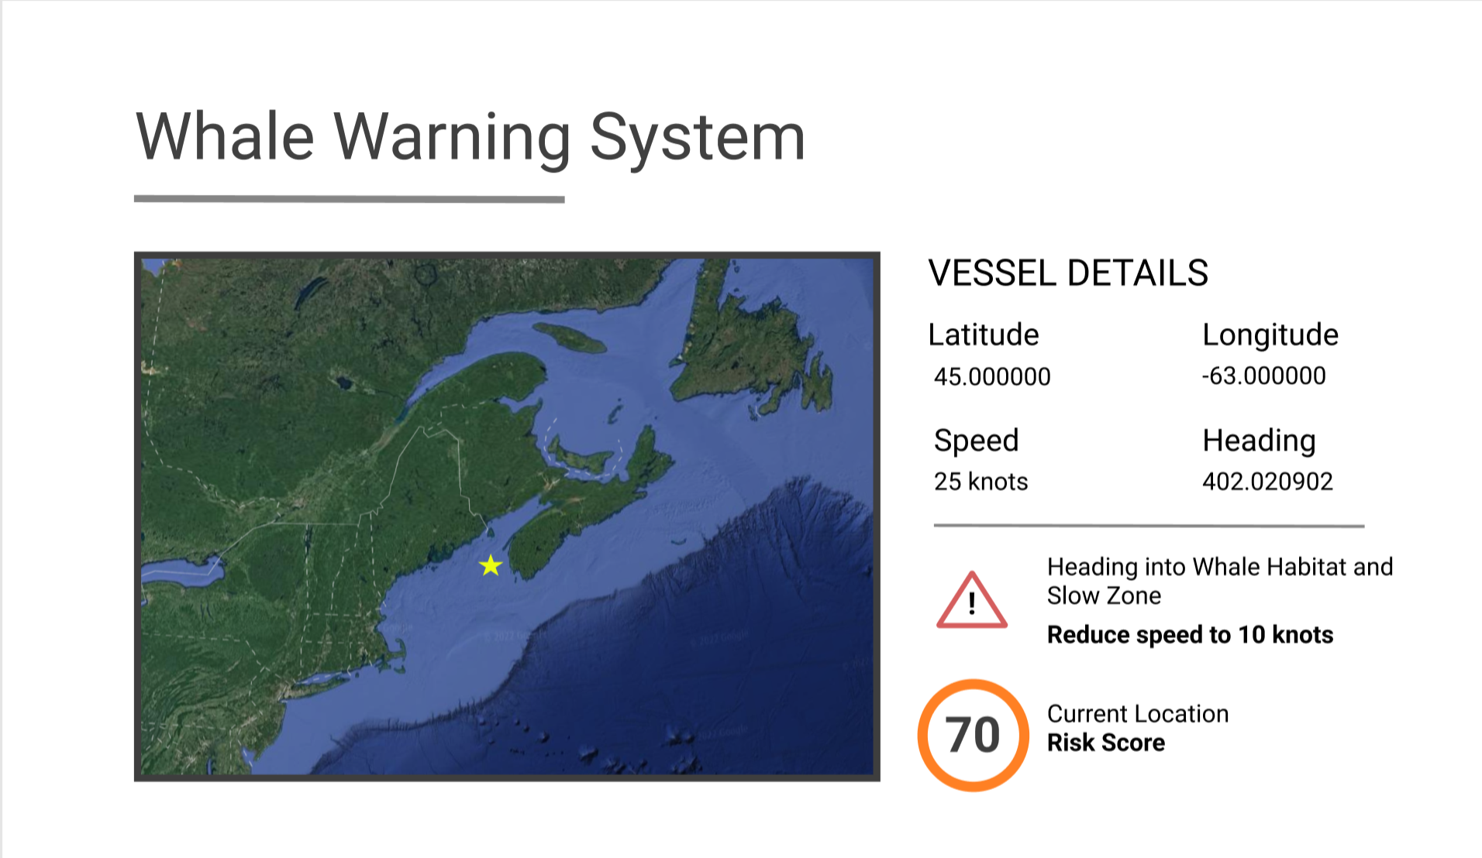
Notes:
Interface on vessel for real time analytics

Slide 7
Future Steps - Policy Implications and Technological Solutions
Limited data on Canadian Waters - mostly US | ⇒ Collaboration with International Organizations
Education / Policy | ⇒ Target high risk vessels = Cargo and Tankers
Technology Requirements | ⇒ Detection systems - whale habitats and slow zones

